Slide 1
Yofficial
Capstone Design 1 Class No.4 / Team No.9
이재원
중앙대학교 컴퓨터공학부
20132697

Slide 2
Content
1. Feedbacks
2. Progression and Trouble Shooting
3. Schedule

Slide 3
Feed Back

Slide 4


FeedBacks
01
Noise Test?

Slide 5
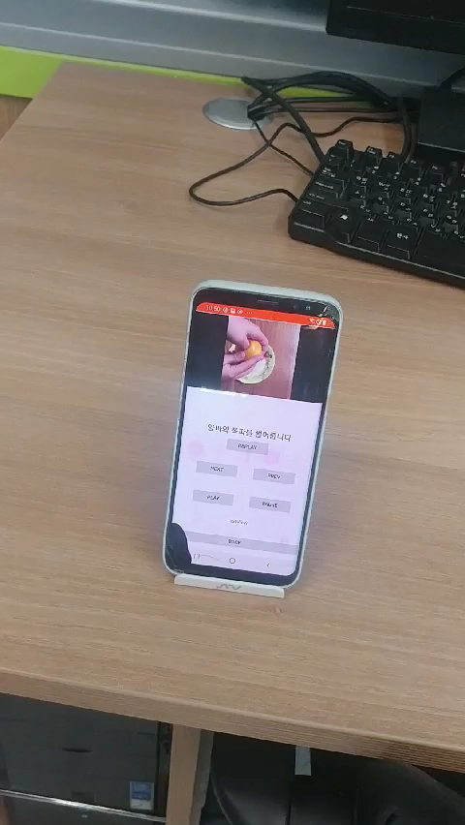
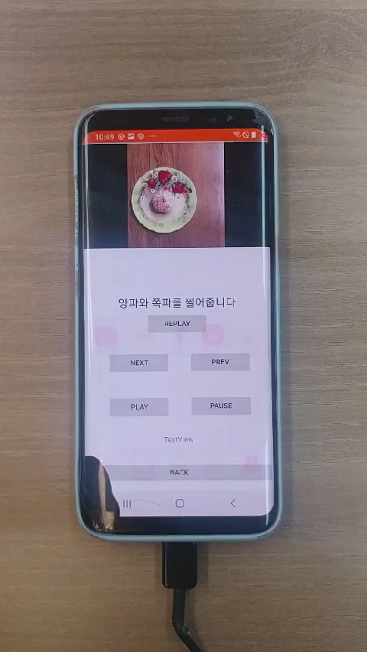
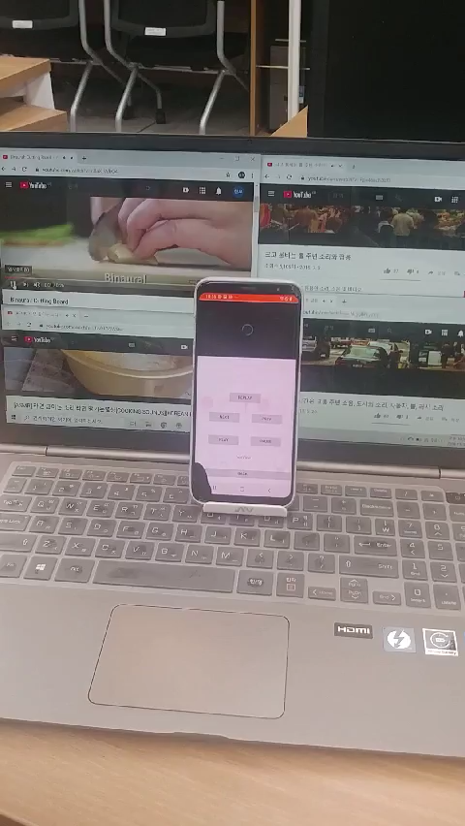
FeedBacks
01

Slide 6


FeedBacks
01
Ingredient Input
삼겹살 200g
돼지고기 삼겹살 200g

Slide 7
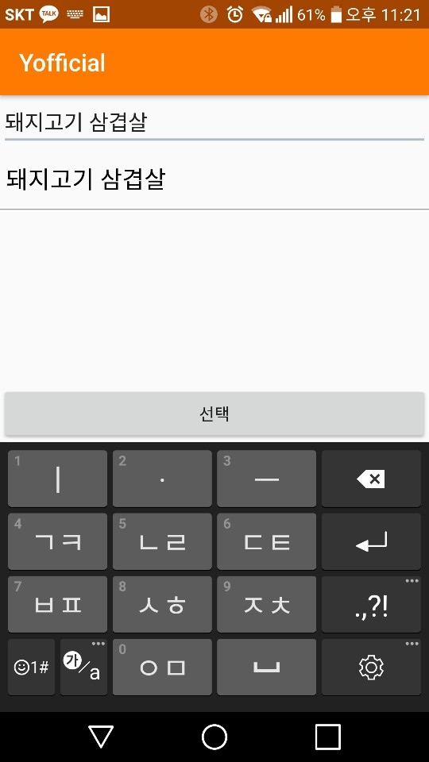
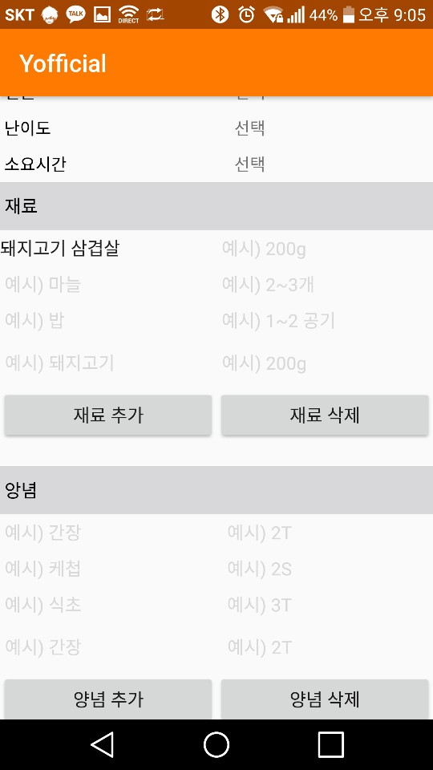
FeedBacks
01
Click!

Slide 8
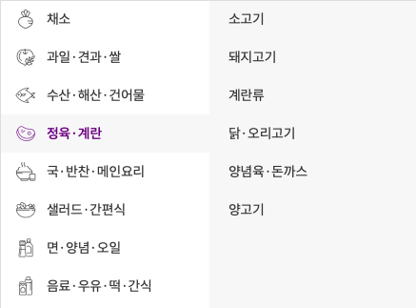
FeedBacks
01
Classification

Slide 9
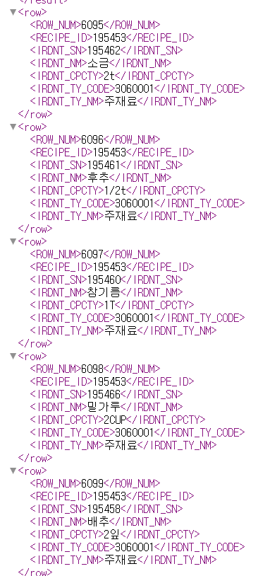
FeedBacks
01
Agricultural Products API

Slide 10
Progression
&
Trouble Shooting

Slide 11
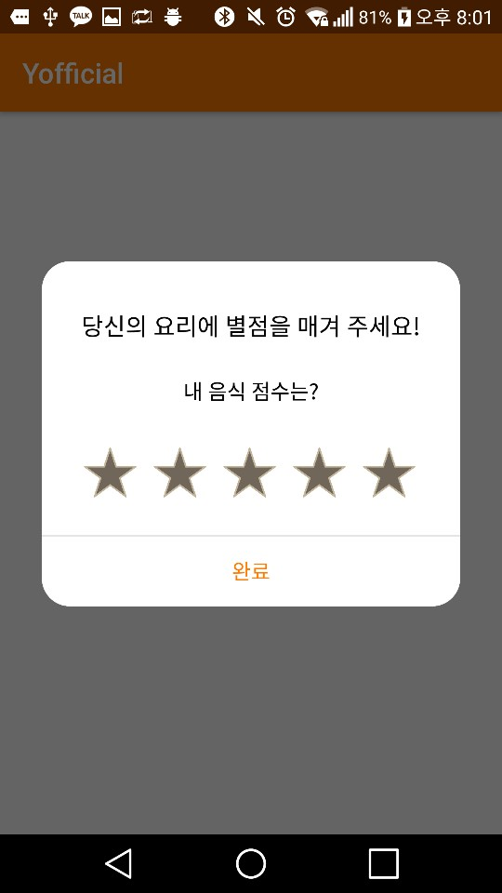
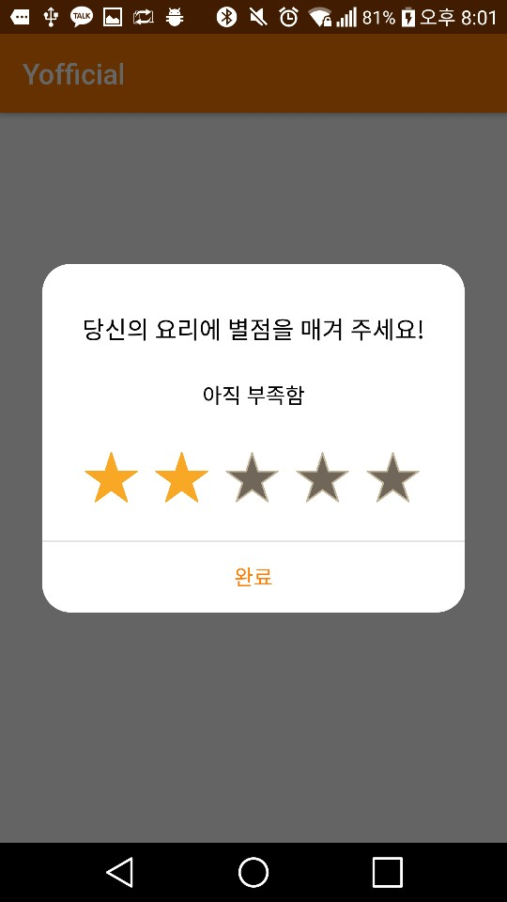
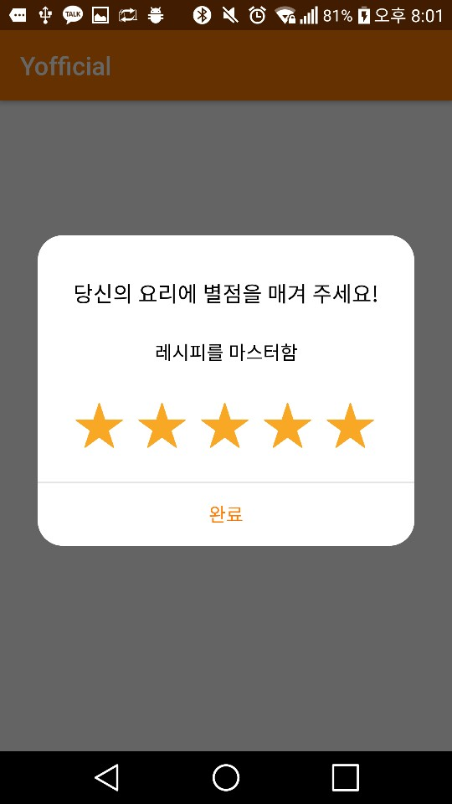
Progression
02
Evaluation Pop Up

Slide 12
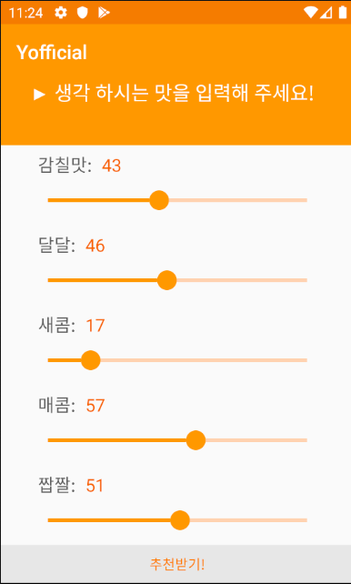
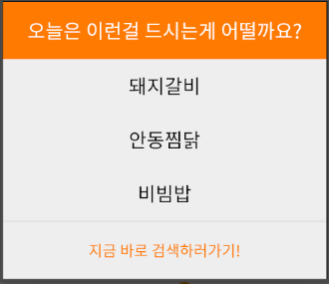
Progression
02
Recommendation

Slide 13
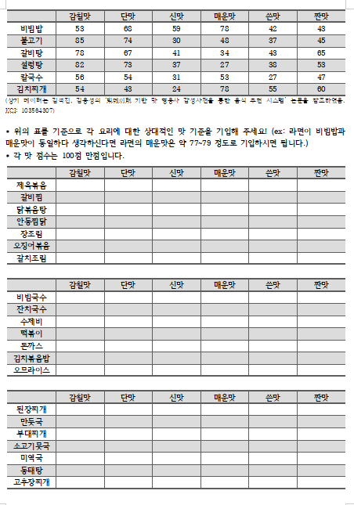
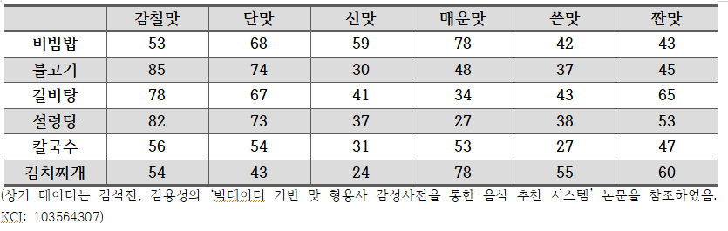
Progression
02
Get Data

Slide 14
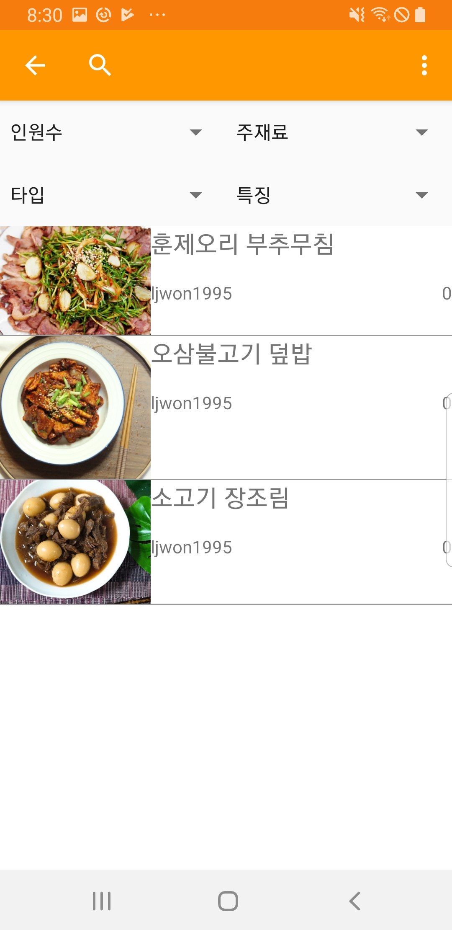
Progression
02
Conditional Search

Slide 15
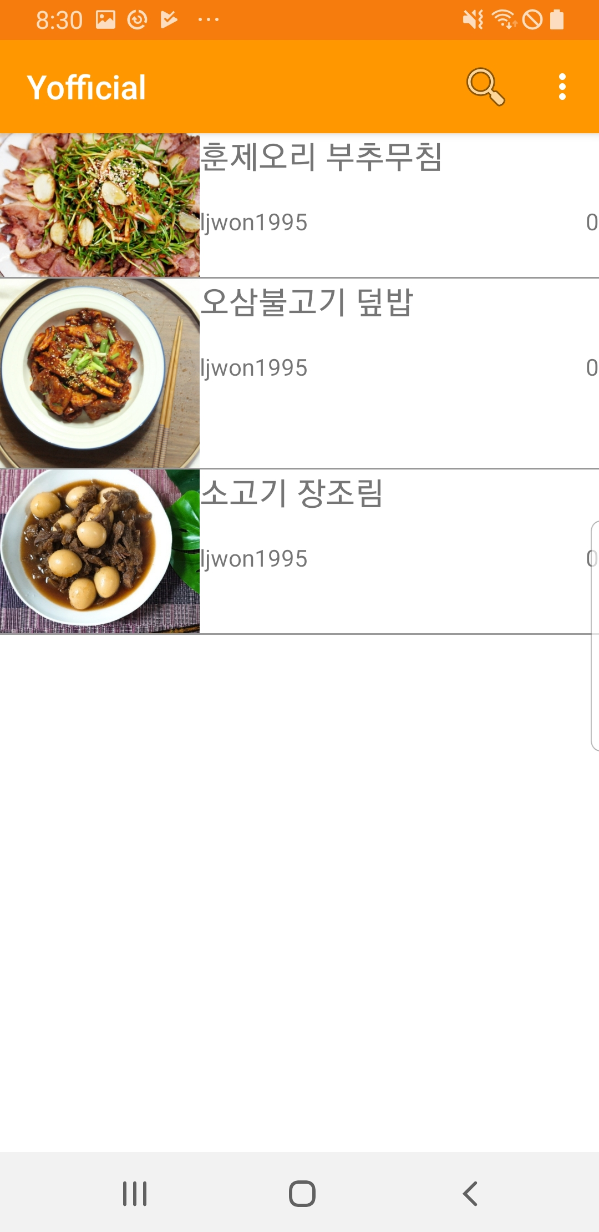
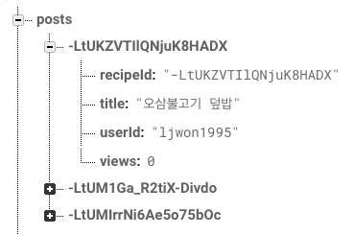
Progression
02
Interlocking with DB

Slide 16
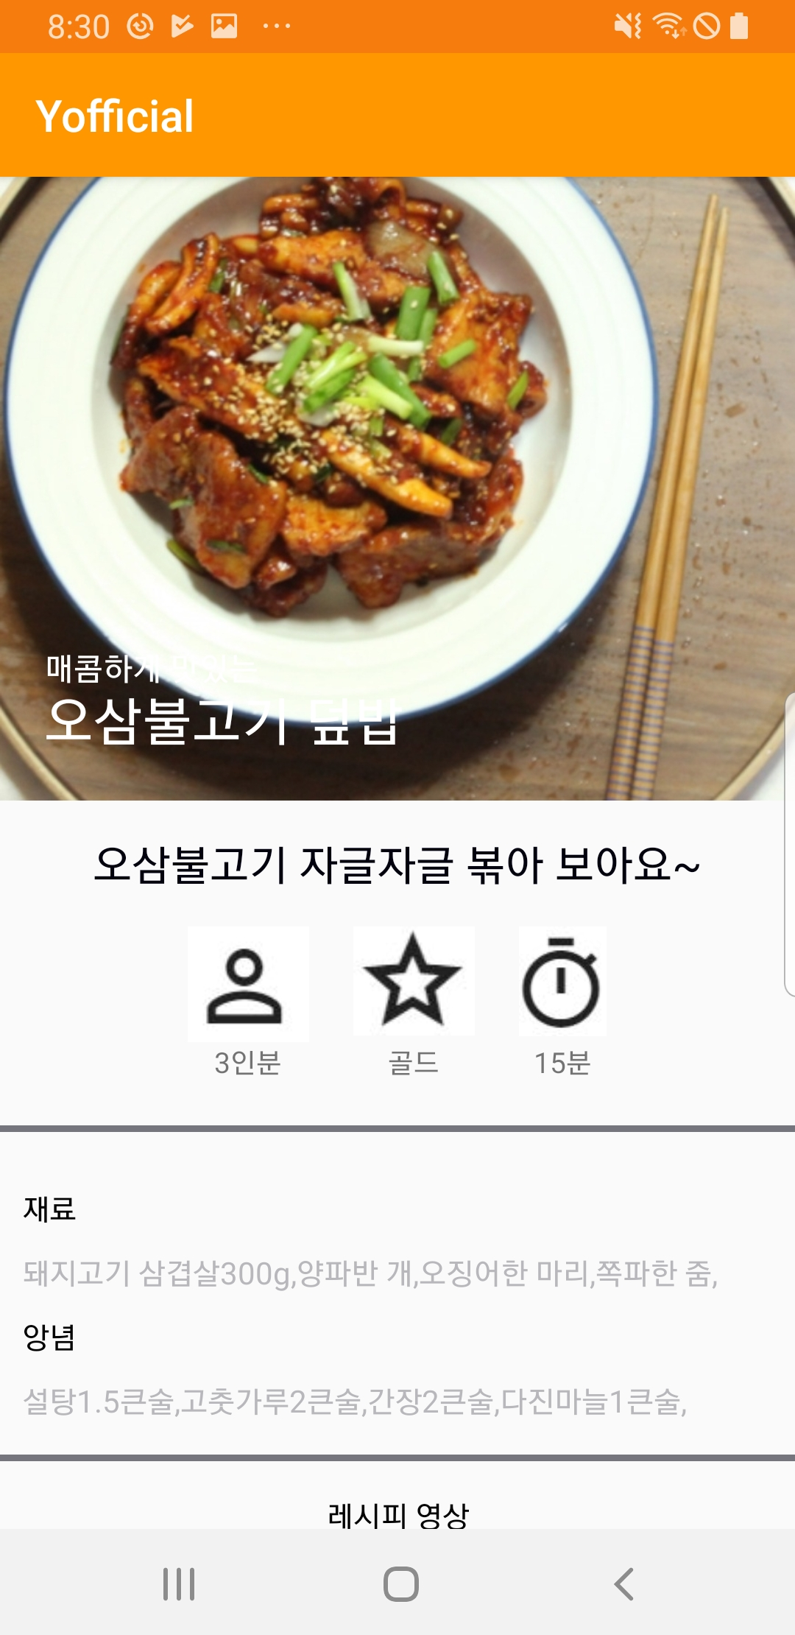
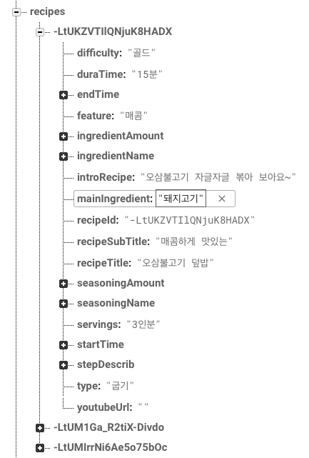
Progression
02

Slide 17
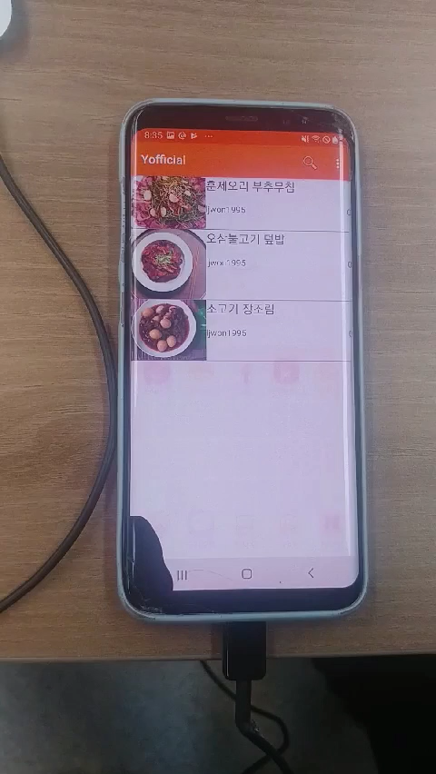
Trouble Shooting
02
UI Before Improving

Slide 18




Trouble Shooting
02

Slide 19
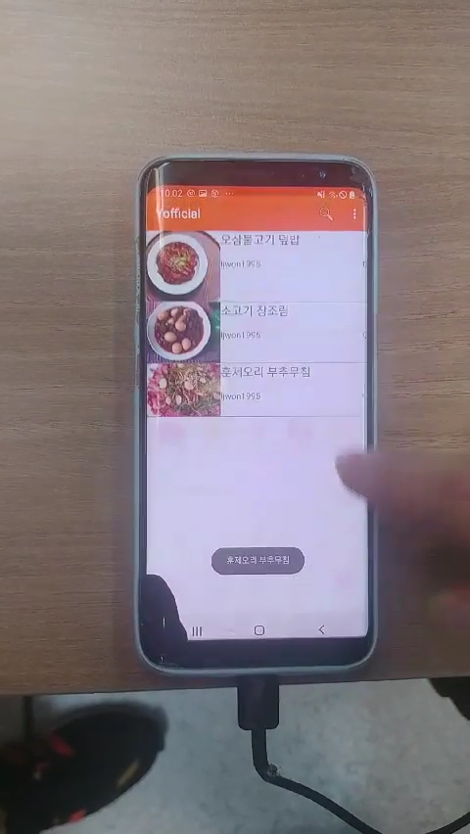
Trouble Shooting
02
UI After Improving

Slide 20
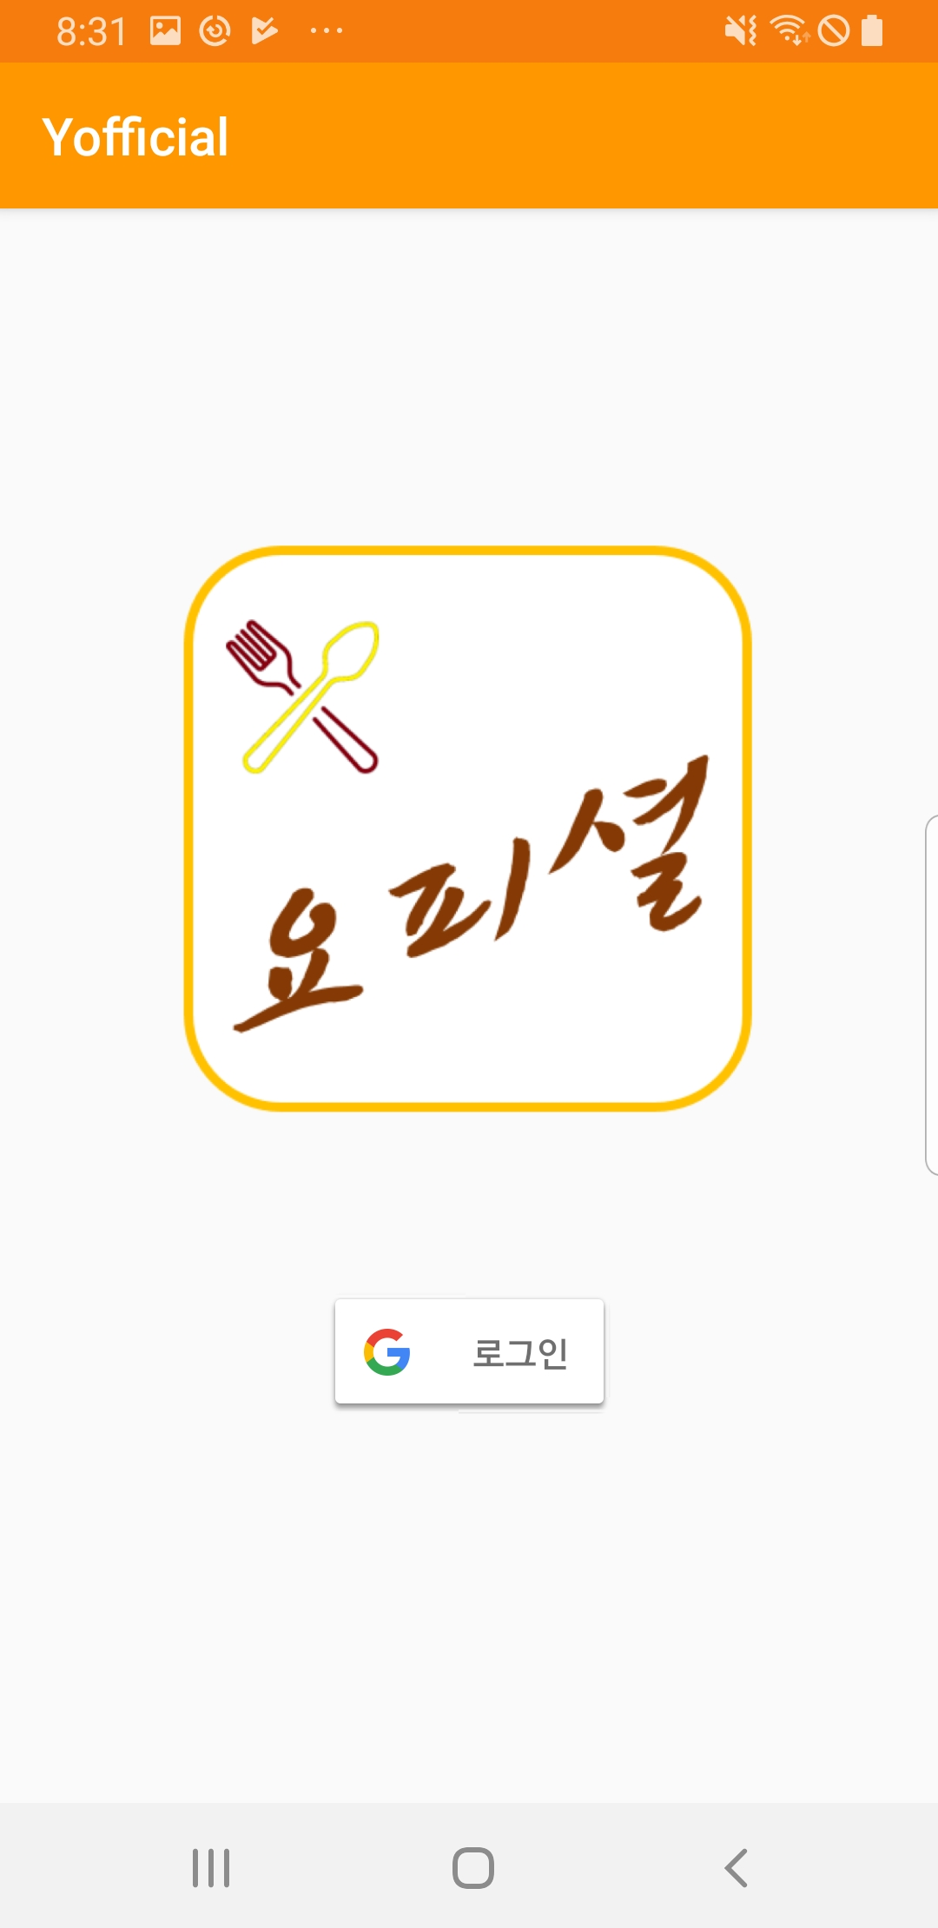
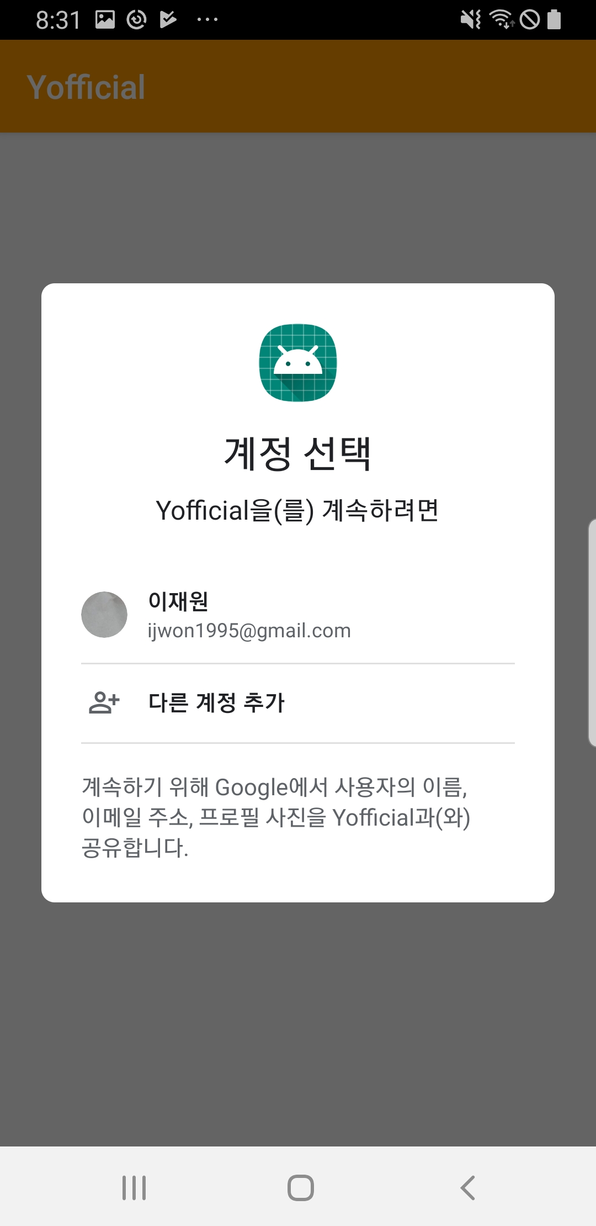
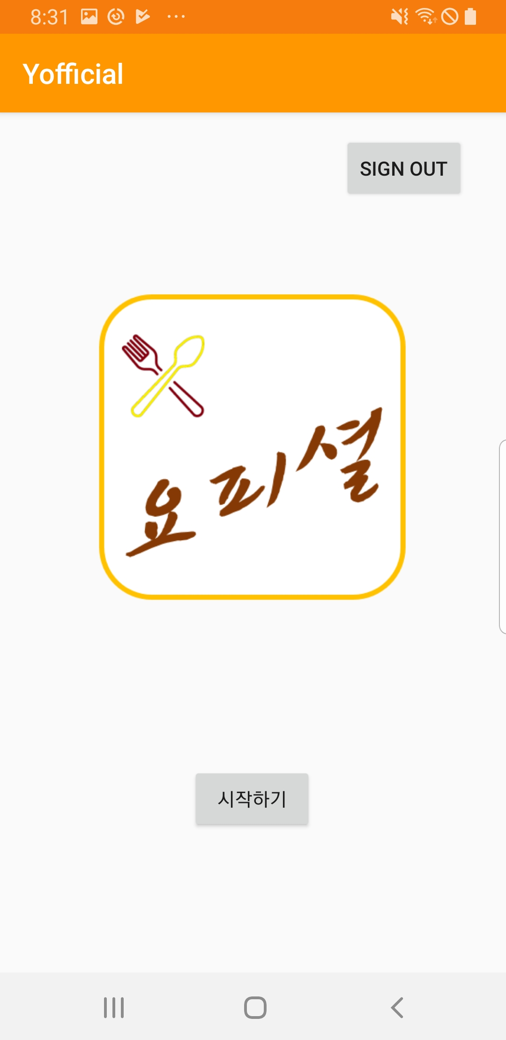
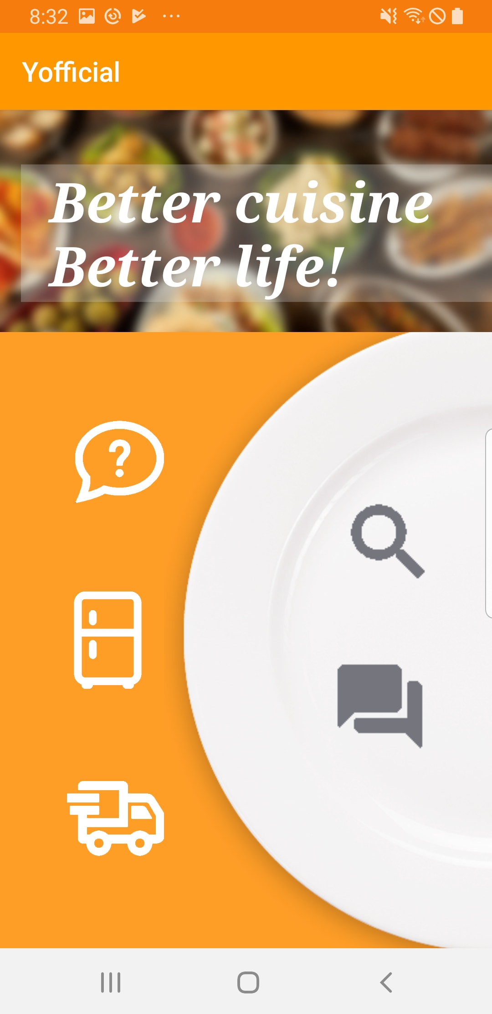
Progression
02

Slide 21
Trouble Shooting
02
Google Login Trouble

Slide 22



Trouble Shooting
02
Google Login Trouble

Slide 23
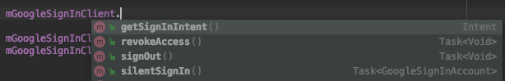
Trouble Shooting
02
Google Login Trouble

Slide 24
Trouble Shooting
02
Google Login Trouble

Slide 25
Schedule

Slide 26
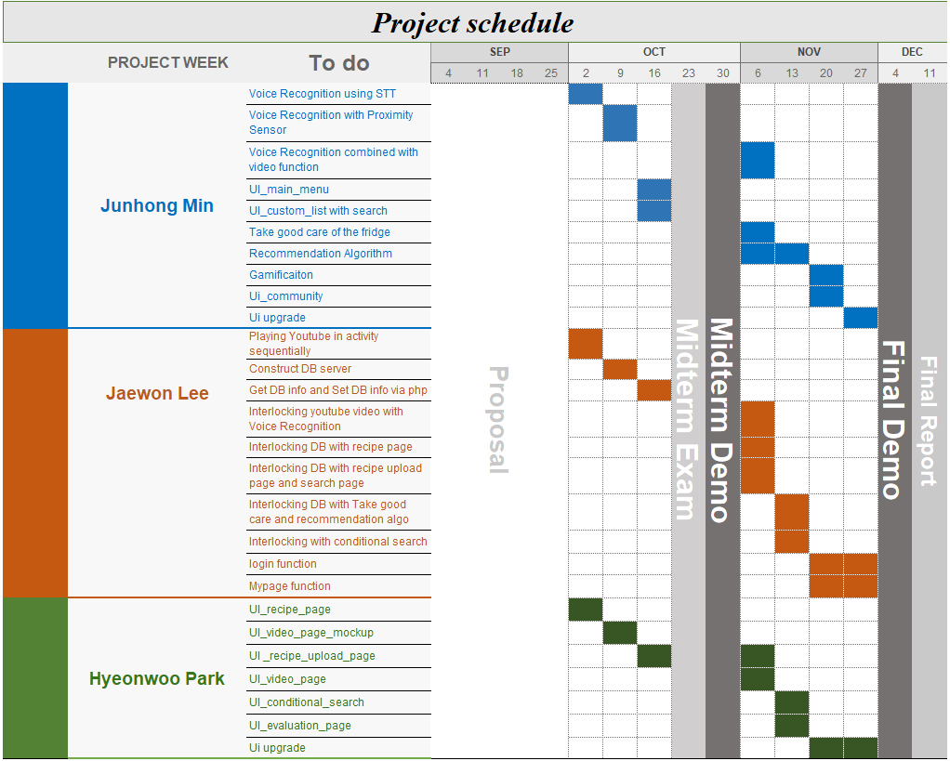
Schedule
03

Slide 27
The end
Thank you

